Slide 1
Chatterpaul Joseph
RF Software System Career Experience
Notes:
https://www.free-power-point-templates.com/free-green-design-powerpoint-template/

Slide 2
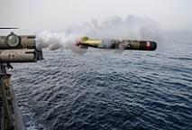
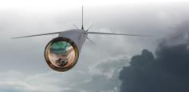









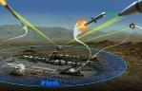















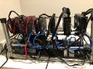


Who am I?
Family
Work
Chicago
Guyana
Indian
School
Hobbies
Intermitted
Fasting
Innovation & Design Thinking
Notes:
The images were obtain from the following locations:
https://en.wikipedia.org/wiki/Guyana
https://en.wikipedia.org/wiki/Chicago
http://www.pawtucketri.com/
https://www.tucsonaz.gov/
https://en.wikipedia.org/wiki/Mark_54_Lightweight_Torpedo
https://www.raytheon.com/capabilities/products/ai3
https://www.raytheonmissilesanddefense.com/capabilities/products/stormbreaker-smart-weapon
https://www.militaryaerospace.com/sensors/article/14168864/airborne-electronic-warfare
https://en.wikipedia.org/wiki/University_of_Rhode_Island
https://online.stanford.edu/innovation-design-thinking
Google Images

Slide 3
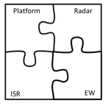

Agenda
Monostatic Air To Ground
Bistatic Surface To Air
Calibration
ISAR Anechoic Chamber RCS
Electronic Warfare
Datalink Modeling
Laser & LADAR Link Budget, Trade-offs and Feasibility
COTS Component, Software & Test Tools, Size, Power, Weight & Cost, Calibration

Slide 4
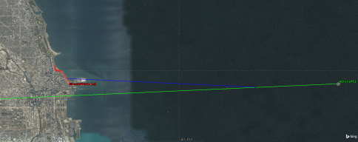
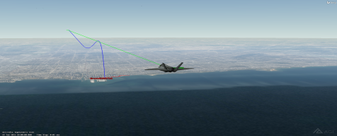
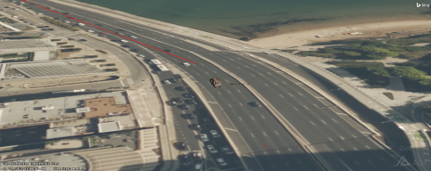
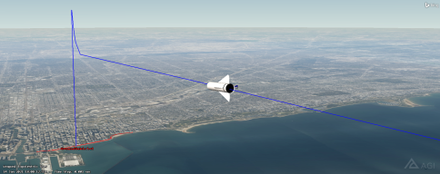
Monostatic Air to Ground Example
Scenario
Platform
Target
Weapons

Slide 5
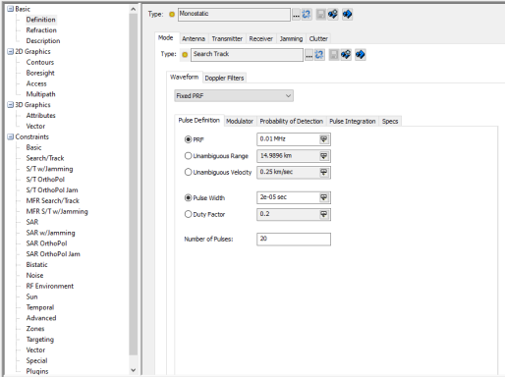
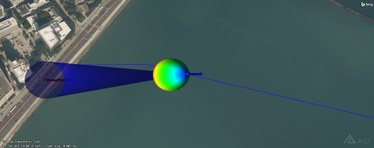
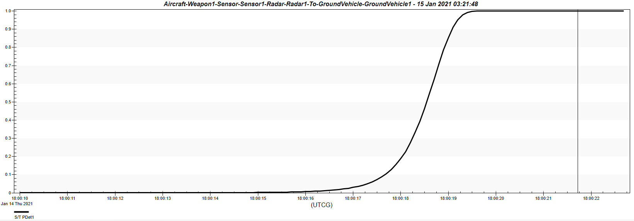
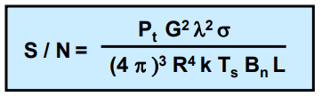
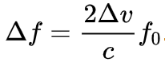
Radiometry
Notes:
https://en.wikipedia.org/wiki/Radar#Radar_range_equation
https://www.ll.mit.edu/sites/default/files/outreach/doc/2018-07/lecture%202.pdf

Slide 6
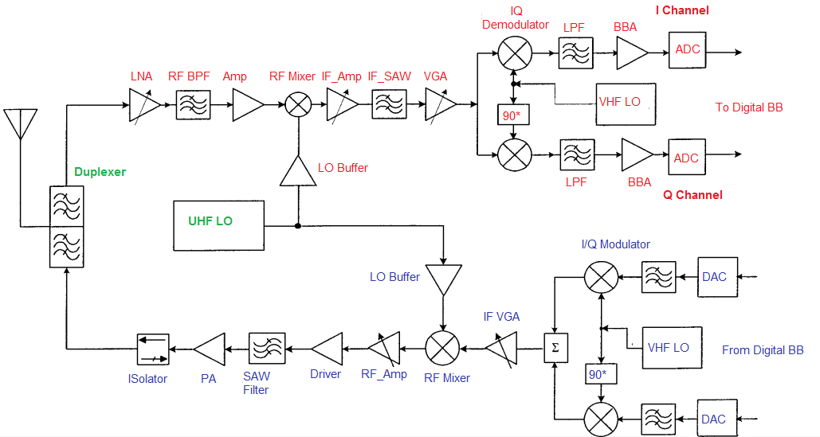
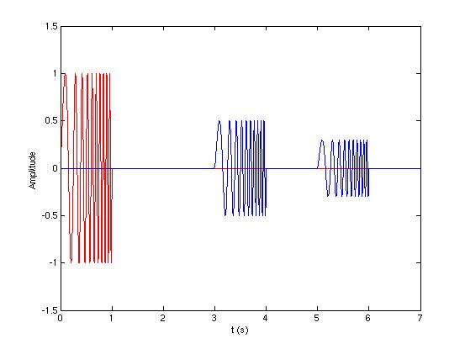
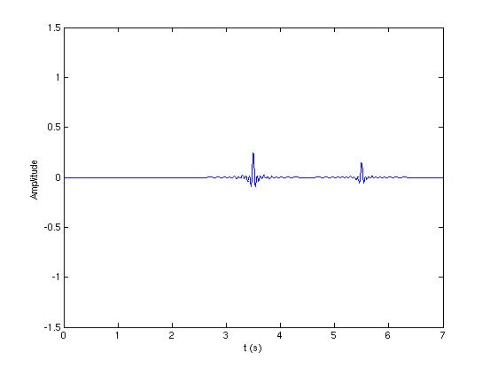
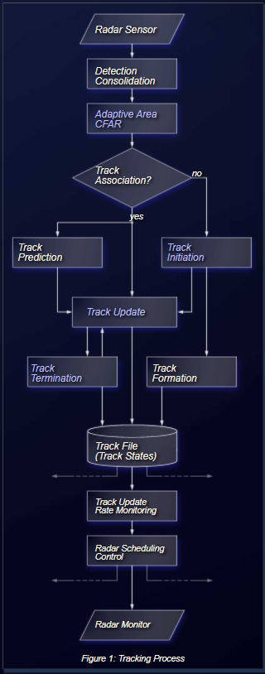
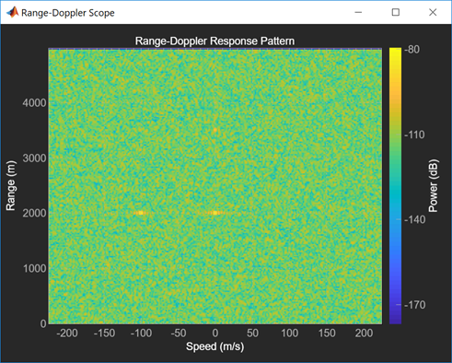
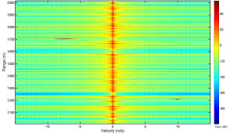
Radar Signal Processing
Pulse Compression
superheterodyne
Radar Doppler with Main Lobe Clutter
Notes:
https://en.wikipedia.org/wiki/Pulse_compression
http://www.techplayon.com/revising-superheterodyne-transceiver-radio-architecture-design-considerations-image-issue-resolution/
https://www.radartutorial.eu/10.processing/sp21.en.html
https://en.wikipedia.org/wiki/Track_algorithm

Slide 7
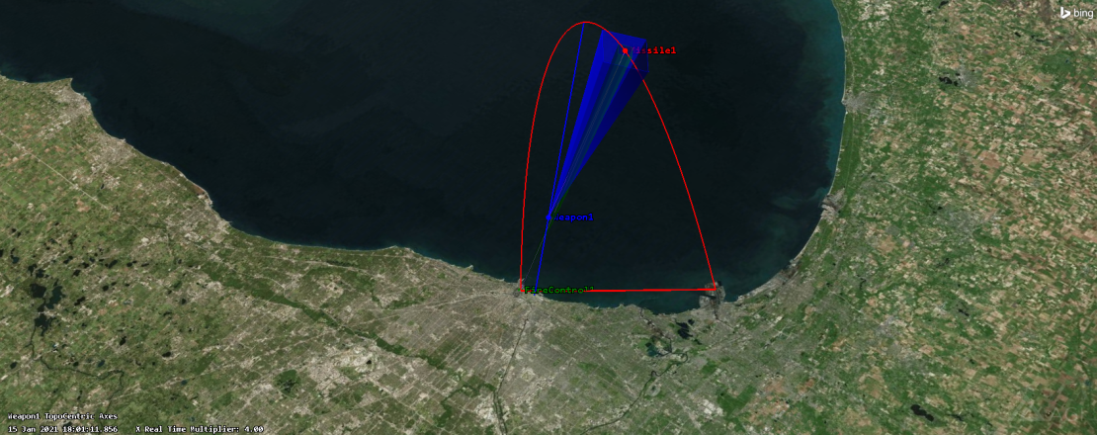
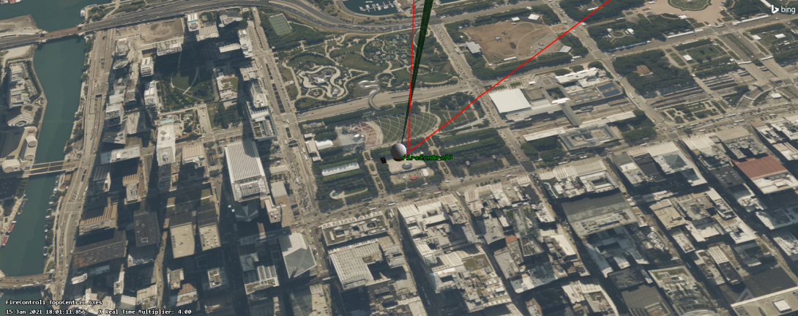
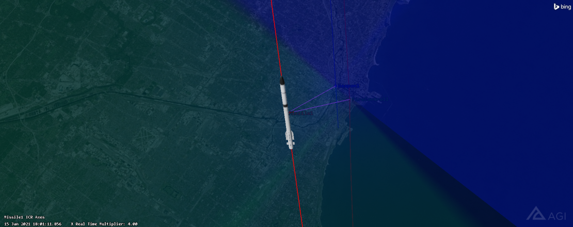
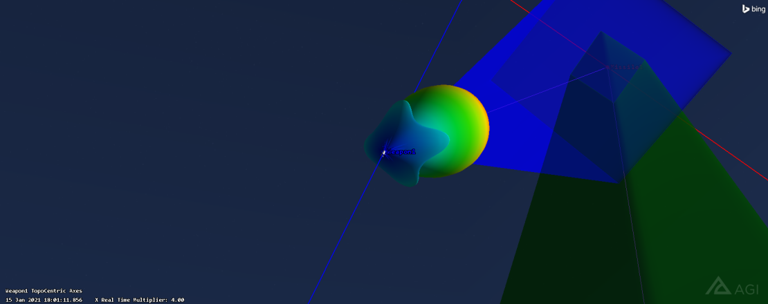
Bistatic (Semi-Active) Surface to Air Example
Scenario
Platform
Target
Weapons
Notes:
https://en.wikipedia.org/wiki/Phased_array

Slide 8
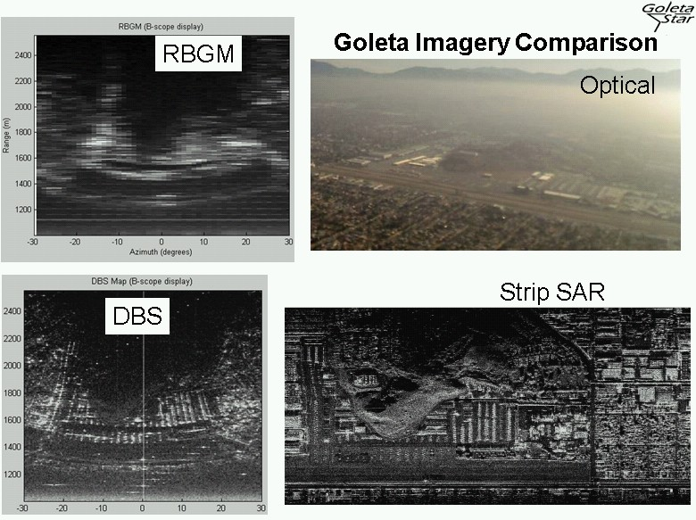
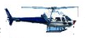
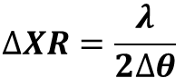
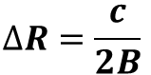
Inverse Synthetic Aperture Radar Anechoic Chamber Radar Cross Section Experience
Anechoic Chamber
Rotation Column with Target Model
Antenna, RF data collection test equipment and control room
Range resolution:
Cross-Range resolution:
$$∆R=\frac{c}{2B}$$
$$∆XR=\frac{λ}{2∆θ}$$
SAR vs. ISAR: Imaged target remains stationary, Radar is on a moving platform, Cross-Range resolution obtained by motion of radar relative to the target (opposite for ISAR)
Notes:
http://goletastar.com/product_development08.html

Slide 9
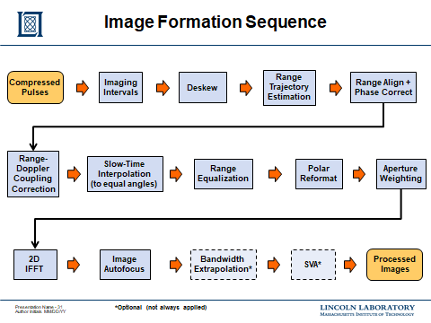
Notes:
IEEE: Radar Conference 2019: MIT Lincoln Laboratory “Inverse Synthetic Aperture Radar for Satellite Imaging”

Slide 10
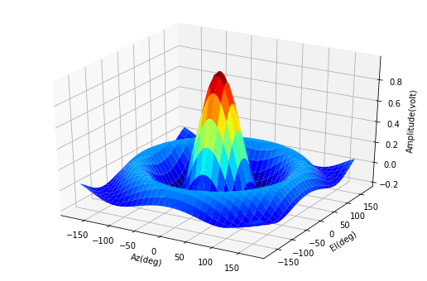
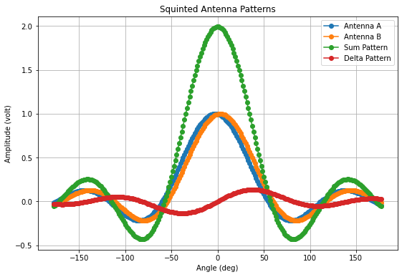
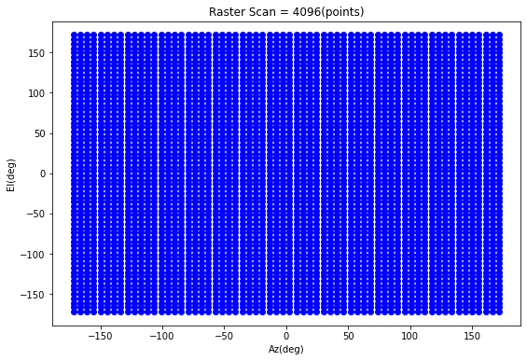
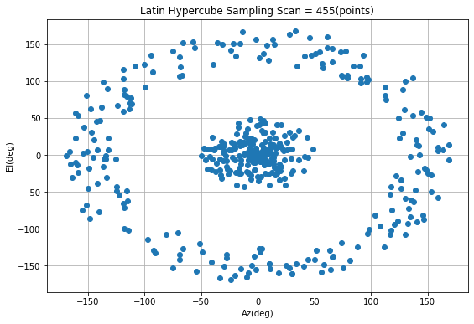
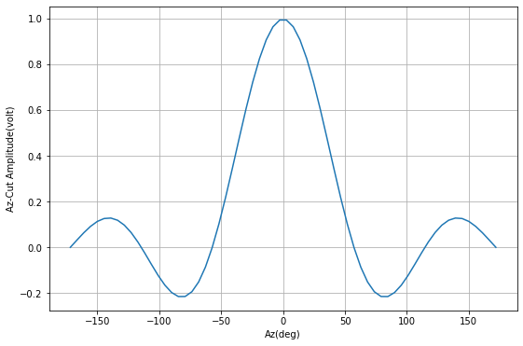
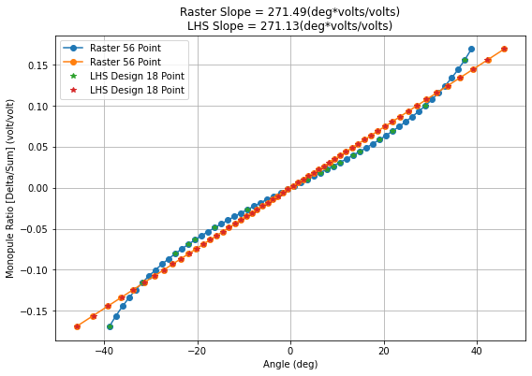
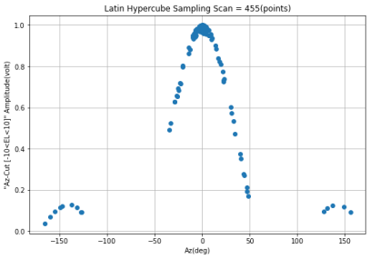

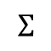
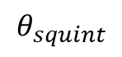
Calibration Optimization Using Design of Experiments (DOE)
After Antenna Pattern Design Verification Testing, utilize DOE for factor production calibration
$$Σ$$
$$θ_{squint}$$
$$Δ$$
1. Peak
2. 3dB BW
3. Peak to
Sidelobe Ratio
Iterate and minimize the LHS Design number of points until the differences in the Antenna Figure of Merits are negligible
Don’t Care about Null
The differences in the monopulse slope is are negligible but only 18 of 56 points are used
Notes:
Calibration: https://en.wikipedia.org/wiki/Latin_hypercube_sampling

Slide 11
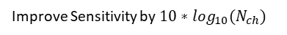
Electronics Warfare [Radar Warning Receiver + Jammer]
Compare PDWs against Mission Data File to identify and track emitters – Deinterleaver, Dwell Scheduler
DRFM store complex IQ data of the emitter, noise, or direct digital signals
Alignment is needed to remove gain and phase imbalance introduce by the hardware between the paths
Reduce False Alarm with M of N or PDI detector
1. Dual Pol Antennas
3. Down Converter
4. Analog to Digital Converter
6. Detector
7a. SW Tracker
8. Digital RF Memory
10. Inverse Channelizer
12. Filter & Power Amplifier
Electronic Support
Electronic Attack
14. Alignment Paths
2. Low Noise Amplifier
3. Anti Alias Filter
5. Channelizer Filter Bank
7. Parameter Encoder
7a. SW PDW
9. Techniques: Delay, Doppler, Mag/Phase
11. Digital to Analog Converter
13. Dual Pol Antenna
Improve Sensitivity by $10∗\log_{10}(N_{ch})$
Measure Time of Arrival, Pulse Width, Magnitude, Phase, Frequency from derivative of phase, Frequency and Phase Modulation
Measure Angle of Arrival, Geo-Location/Interferometry , Polarization Tilt/Ellipticity, Patterns - Scan, PRI, Frequency
Delay create Range False Targets,
Doppler create Velocity False Targets, Magnitude and Phase can create Angular False Targets
Notes:
https://www.mathworks.com/help/dsp/ref/channelizer.html

Slide 12
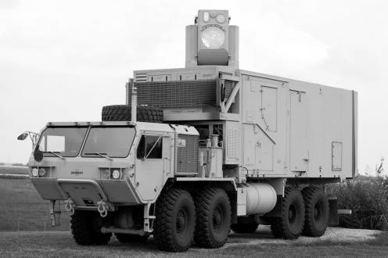
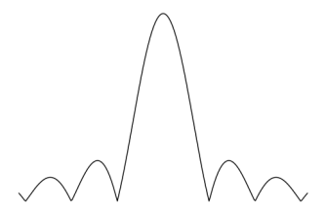
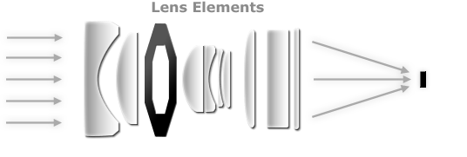
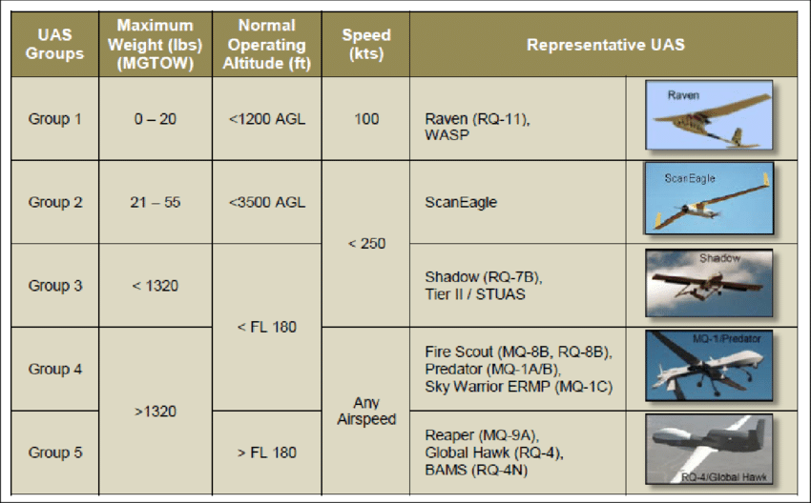
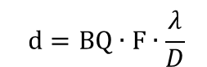
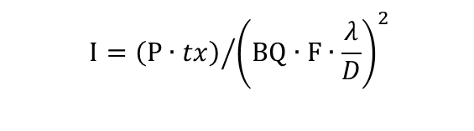
Laser 101
Diffraction Limited Focal Spot on Target
d
$$d=BQ∙F∙\frac{λ}{D}$$
Intensity (W/cm²) is Power on Target over Area
$$I={\left(P∙tx\right)}/{{\left(BQ∙F∙\frac{λ}{D}\right)}^{2}}$$
tx is the transmission fraction through air/haze/cloud/etc.
D
Focusing
F
Target
Laser Source
Peak Power P(kW) | Wavelength λ(um) | Diameter D(cm) | Beam Quality BQ | Focal Length(km)
1 – 10 | ~1 | 5 – 10? | 1.4 – 2 | ≤ 20
Pulse Width (ns) | Pulse Energy (mJ) | Cost ($K)
.010 – 10 | .01 – 10 | $$≥{20}^{∗}$$
Notes:
Vehicle: https://www.defense.gov/observe/photo-gallery/igphoto/2002121156
Lens: https://www.cambridgeincolour.com/tutorials/camera-lenses.htm
UAS Target: https://www.researchgate.net/figure/US-DoD-Unmanned-Aerial-System-Group-Classifications-14_fig3_295873907
*Based on laser cutter: https://www.google.com/search?q=high+power+laser+cutter+cost but it’s not eye-safe

Slide 13
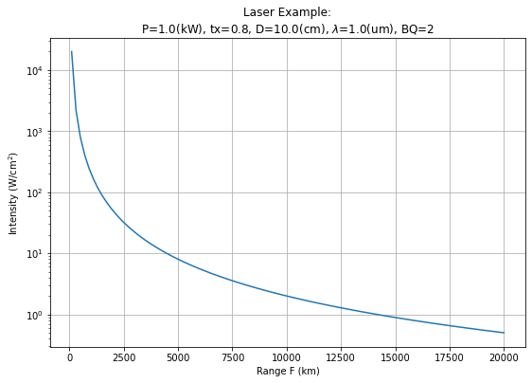
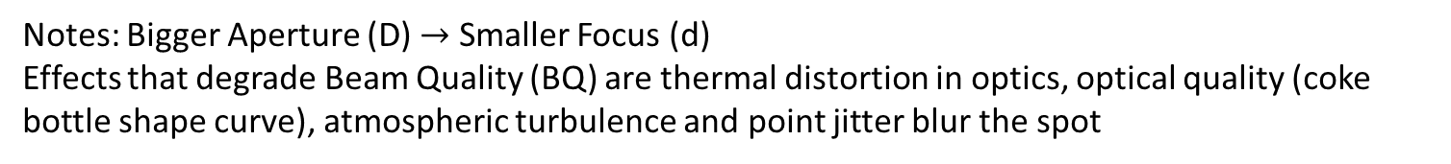
A Laser Performance Example: Power on Target
Notes: Bigger Aperture (D) $→$ Smaller Focus (d)
Effects that degrade Beam Quality (BQ) are thermal distortion in optics, optical quality (coke bottle shape curve), atmospheric turbulence and point jitter blur the spot
Example:
$$If P=1\left(kw\right),tx= .8,$$
$$F=20 \left(km\right), D=.1\left(m\right),$$
$$λ=1 \left(um\right),BQ=2,$$
$$then d=40\left(cm\right) and$$
$$I=0.5(\frac{w}{{cm}^{2}})$$
“Hard” Structure Lethality – Direct Energy
“Soft” Lethality – Blinds IR Seekers

Slide 14
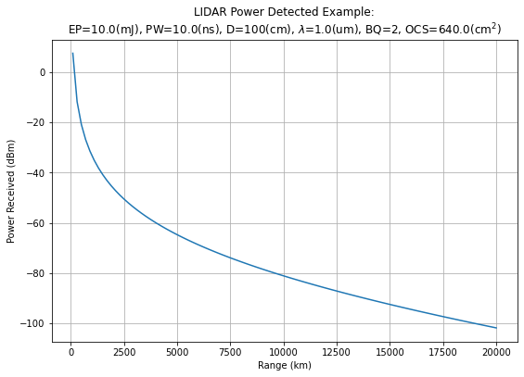
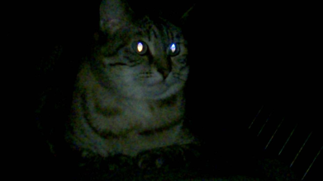
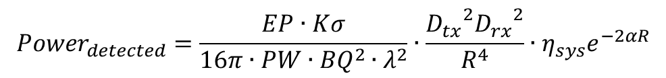

A Laser Performance Example: Detect Target
Using a form of the LADAR/LIDAR range equation to determine the detected off a target
$${Power}_{detected}=\frac{EP∙Kσ}{16π∙PW∙{BQ}^{2}∙λ^{2}}∙\frac{{D_{tx}}^{2}{D_{rx}}^{2}}{R^{4}}∙η_{sys}e^{−2αR}$$
$$EP is the pulse energy$$
$$K is the illumination constant, in this case set to \frac{1}{e}$$
$σ=4∙ρ∙A_{target}$ is the target optical cross section (OCS)
$$PW is the pulse width$$
$$BQ is beam quality$$
$$λ is wavelength$$
$$D is the diameter of the aperture \left(tx and rx\right)$$
$$R is the the range to the target$$
$$η_{sys} is the transmittance of the internal optics$$
$$∝ is the atmospheric extinction coefficient$$
A LADAR would need at > ~60 (dBm) for detection, which would requires a Higher Energy, Larger Diameter and Larger OCS
What is reasonable OCS and Power Receiver for an IR camera and delta temperature is need?
The ability to see the reflections off a target is dependant on the optical cross section of the target. If there is an IR seeker at your laser’s wavelength, then there could be a strong reflection like a cat’s eye reflecting light.
Notes:
Cat’s Eye: https://www.youtube.com/watch?v=qU6Sz1SIwPs
Example Designator: https://www.military.com/video/operations-and-strategy/air-strikes/laser-targeted-strike-in-afghanistan/2707623470001

Slide 15




Commercial Off The Self Laser Challenges
- Atmospheric effects can potentially make LADAR detectable to adversaries
- Short pulses mean better range and resolution but also scatter off particulates and water droplets in the atmosphere
- Lasers are inefficient, so higher prime power and heat dissipation issues
Atmospheric Loss and 1/R⁴ are significant non-design terms in the power receive
Notes:
Particle Radius Wavelength: https://www.e-education.psu.edu/meteo300/node/785
Transmitted by the Atmosphere: https://commons.wikimedia.org/wiki/File:Atmospheric_Transmission.png
COTS Rare-earth Lasers: https://www.researchgate.net/figure/Summary-of-upconversion-rare-earth-doped-ZBLAN-fiber-lasers-with-the-highest-output_tbl2_43170278

Slide 16








RF Rectangular Antenna Phased Array Hardware
$$d_{max}=\frac{λ}{2}$$
Recommend Design Tools:
CST – Antenna
Microwave office - HW
Python Analysis
$$d_{max}=0.8∙λ$$
Pulse Width PW(us) | Pulse Repetition Frequency PRF (kHz) | Process Bandwidth BW(MHz)
< ~60 | < ~8 | $≤$ 1
Cost $K
(> 20 for unambiguous range rate)
Smaller bandwidth, lower noise level but also lower range-resolution
# RF Channel
Peak Power P(W) | Wavelength λ(mm) | Antenna Gain G (dB)
256*.010 = ~2.5 to 10 | ~10 | 24
Grating Lobes
To get 30 (dB) would require 32x32 array
Notes:
https://www.anokiwave.com/products/index.html
https://www.xilinx.com/products/boards-and-kits/device-family/nav-zynq-ultrascale-plus-rfsoc.html

Slide 17




Radar Monostatic & Bi-static Link Budget
Monostatic Parameters:
RCS = -20 (dBsm), Bw = 100e3 (Hz)
Ptx = 10 (W), Freq=30e9 (Hz)
G=24 (dB), NF=6 (dB), Loss=1 (dB)
Bi-static Parameters:
Ptx =100 (W), Gtx=40 (dB), Grx=24 (dB)
For reasonable power and gain parameters, the SNR is too low for the given RCS and geometry, resulting in the target being undetectable.

Slide 18



Optimistic Link Budget
Monostatic Parameters:
RCS = -20 (dBsm), Bw = 100e3 (Hz)
Ptx = 1 (kW), Freq=30e9 (Hz)
G=30 (dB), NF=6 (dB), Loss=1 (dB)
Bi-static Parameters:
Ptx =10 (kW), Gtx=40 (dB), Grx=24 (dB)
For optimistic power and gain parameters, the SNR is become positive for the given RCS and geometry under 5 km, resulting in the target being coming detectable.
Note: Generally, there is a burn through range at which a mono-static seeker outperforms the bi-static seeker. Also, note that coherently integrating 64 pulses is only applicable to the mono-static case.

Slide 19


Challenges – Clutter, RCS
In order to solve these hardware radar problem, it is better to build a custom seeker instead of trying to repurpose a solution from a company like ImSAR
Base-band frequency
Notes:
https://www.researchgate.net/figure/Ku-band-clutter-reflectivity-values-at-30-degree-grazing-angle-VV-polarization-13_tbl1_253215976
https://www.semanticscholar.org/paper/Numerical-Computation-of-the-Radar-Cross-Section-of-Kenyon-Dogaru/6c3170d1f8725bf1e552b63e0fda76527949e100
https://apps.dtic.mil/sti/pdfs/ADA622300.pdf

Slide 20









Antenna Aperture & Seeker Design
$$d_{max}<\frac{λ}{2}$$
Beamforming
Grating Lobes
Phase Array Antenna
Radar Signal Processing is Application Dependent: All Range vs Stretch Processing, Single Pulse vs Multiple Pulses, Moving vs Stationary Target
256-Array
Rapid Prototype
256-Array | 27.5-30 GHz | 60 dBm EIRP | $10K
RF SoC | 4 GHz | 8 Rx/Tx | $10K
Beam-steering
Channel Alignment
Channel
Alignment
Calibration over Field of Regard
Switch network
Or Cal Sources
Polarization
RF SoC
Field of View
Notes:
https://www.microwaves101.com/encyclopedias/phased-array-antennas
https://en.wikipedia.org/wiki/Side_lobe
https://en.wikipedia.org/wiki/Polarization_(waves)
https://www.xilinx.com/products/boards-and-kits/device-family/nav-zynq-ultrascale-plus-rfsoc.html
https://www.anokiwave.com/products/index.html

Slide 21
Summary
Radar System Algorithm Development and Production lead
Worked across the lifecycle development of several radar seekers/sensors in the areas of automatics target recognition algorithm and performance assessments
Improve manufacturability by increasing yield by over 30% and reducing calibration time by over 90% by applying Design of Experience methodologies
RF EW System Lead
Provide technical leadership for half dozen system engineers and close cross coordination within the multi-disciplinary teams of software, firmware and integration & test
Support three proposals in emerging strategic area
Provided analytical insight to the technical volume ConOps, where my weapon systems background knowledge was invaluable
Growth opportunity for me to support the cost volume, where I learned the Basis of Estimate process
Lead/co-author author for 7 symposium or conference publication
Mentor for the high school involvement partnership program

Slide 22
Sr. Embedded Software Engineer
300100 Research & Development · Reston, Virginia [I am seeking remote opportunity]
Senior Embedded Software Engineer [I been mostly on the System Engineering Career Path]
Embedded Software Developer for Software-Defined Radio Systems [I been significant depth on Radar and EW]
Location: US
Job Opportunity Summary
Satelles is seeking an experienced embedded software engineer to join the team developing state-of-the-art user equipment for the company’s satellite-based position, navigation, and timing (PNT) solutions. The selected candidate will design, develop, modify, enhance and implement real-time firmware for digital signal processing on ARM, FPGA, ASIC, and DSP platforms. [Radar Monopulse Angle and EW Angle of Arrival]
This position is ideal for a hands-on embedded software engineer who is seeking an opportunity to develop new systems based on a unique and patented space-based technology. [I’m looking for getting back to hands-on work. I have Space Payload experience + Navy, Army, Airforce]
MAJOR DUTIES AND RESPONSIBILITIES
Work with an internal development team and with commercial partners to implement the company’s flagship Satellite Time and Location (STL) solution on new platforms
Codes, tests, and debugs new firmware and makes enhancements to existing firmware [Radar Monopulse Angle and EW Angle of Arrival]
Codes and performs unit and integration testing of firmware to ensure proper and efficient execution and adherence to business and technical requirements [Uplifted the V&V team with Code Practice and Peer Review -> Bravo Award]
Collaborates with internal customers and technical peers to solve complex software problems [Architect Program -> Technical Fellows]
Influences system design by identifying and recommending design and requirements needs for future enhancements[Strong Systems Background]
Follows established configuration/change control processes [Experience with IBM, SVN, Git]

Slide 23
REQUIRED QUALIFICATIONS Skills/Abilities and Knowledge
Deep understanding of embedded system architectures [Career in both Modeling, Simulation, Analysis and in Software Integration Lab (SIL)]
Demonstrated competency with embedded software development environment and tools for real-time embedded operating systems (RTOS), such as VxWorks and FreeRTOS [1st internship research affordable RTOS]
Strong ability to develop, implement, and troubleshoot advanced real-time digital signal processing solutions on embedded systems platforms with ARM and DSP processor components. [Very comfortable in SIL environment]
Skilled in programming concepts including object-oriented design, data structures, algorithms, and multithreading [Use OO, Parallel Processing]
Solid understanding of memory management on embedded platforms [Build circular buffer]
Experience with various hardware interfaces such as RS-232, UART, SPI, I2C, and USB [Use UART for FPGA communication]
Knowledge of networking protocols including TCP/IP and UDP [Use UDP for Data logging]
Ability to debug both sides of the Hardware/CPU interface, using C/C++, to optimize performance [Very comfortable in SIL/HIL environment]
Integration experience with purpose-built hardware platforms (using FPGA, ASIC or other custom devices) Ability to work seamlessly within a team as well as manage individual tasks [Very comfortable in I&T role and collaboration across discipline]
Proven ability to work independently; designing, developing, and deploying solutions, and delivering projects on time with minimal direction
Ability to listen and evaluate all opinions without bias, and contribute to a common culture of excellence [Numerous achievement awards]
Excellent communication skills [Numerous customer review]
U.S. Citizenship is required for this position due to government contracts. [Active Clearance]

Slide 24
Technologies and Tools
ARM, FPGA, ASIC, DSP, C++, RTOS, Linux development environment [Integrated Flight Simulation in Redhat Linux]
Skills with Matlab/Octave, Python, verification or test automation [Prototype in MATLAB/Python -> Implement C++ and using Robot Automated Framework]
Education and Work Experience
BA/BS in Engineering, Computer Science, or related field, with 7+ years of related work experience.
MS/Ph.D. in Engineering, Computer Science, or related field, with 5+ years of related work experience. [2 BS in EE & CE, MS in EE and 15+ years of Experience]
DESIRED QUALIFICATIONS
Experience with digital radio systems such as GPS/GNSS or software definable radios [Radar and EW SDRs]
Knowledge of key DSP techniques including correlation, FFT, and phase-locked-loops [Taught FFT (Cooley - > URI) to junior or non-DSP engineer]
Familiarity with common RF/HW/FW/SW tools such as oscilloscope, logic analyzer, signal generator, spectrum analyzer, Chipscope, GDB, JTAG,
Experience with RF/hardware design and debugging [Rented Keysight UXG and Spectrum Analyzer]
Ability to read and understand schematic drawings and component datasheets [Architect must be drive the HW design]
Experience working with bootloaders

Slide 25
ABOUT SATELLES
Satelles provides secure time and location signals from low Earth orbit (LEO) independent of the Global Positioning System (GPS) and other Global Navigation Satellite Systems (GNSS). Satelles created its Satellite Time and Location (STL) service for the purpose of safeguarding against devastating attacks to GPS/GNSS capable of disrupting or disabling electrical grids, wireless communications networks, financial systems, and other private and public infrastructure in ways that seriously imperil the safety and security of our society. Available anywhere on the planet, the STL service is backed by more than 40 patents and delivers assured positioning, navigation, and timing (PNT) via a cryptographically protected satellite broadcast signal that is stronger and more secure than other solutions. The company offers assured PNT at levels of stability, reliability, and trust required by commercial enterprises and government entities across a range of critical infrastructure, IoT, and cybersecurity applications. Satelles partners with satellite receiver manufacturers to incorporate STL signal support into today’s latest equipment, bringing the benefits of Satellite Time and Location to customers around the world.

